Slide 1


Is delay always
harmful to precision?
Nikolett Német*, Scott Parkins
University of Auckland,
The Dodd-Walls Centre for Photonic and Quantum Technologies
Matariki Workshop on Quantum Science 20/03/16
*n.nemet@auckland.ac.nz

Slide 2
Measurement precision
Origins of uncertainty
Classical: temperature, gravitational field, trembling of earth etc.
Quantum: Heisenberg’s uncertainty, Standard Quantum Limit
Precision measurements
Temperature
Magnetometer
interferometry

Slide 3
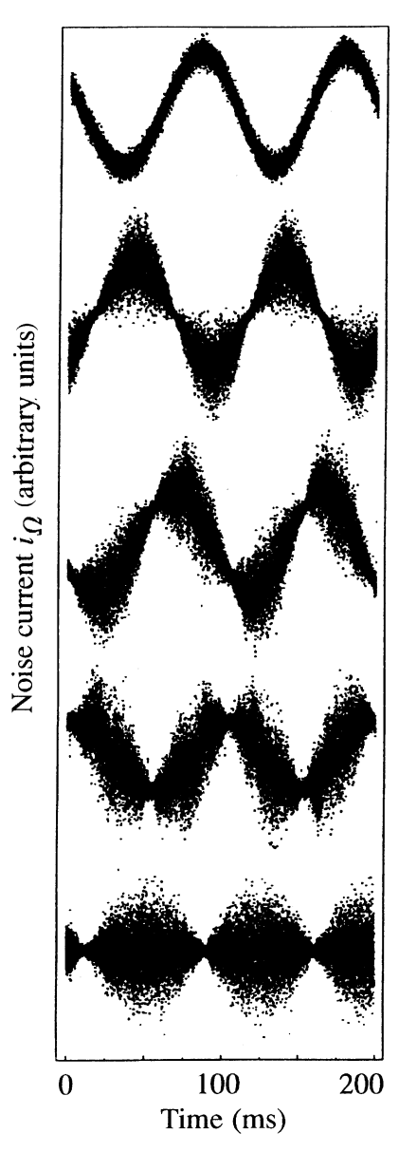
Squeezed State

Slide 4
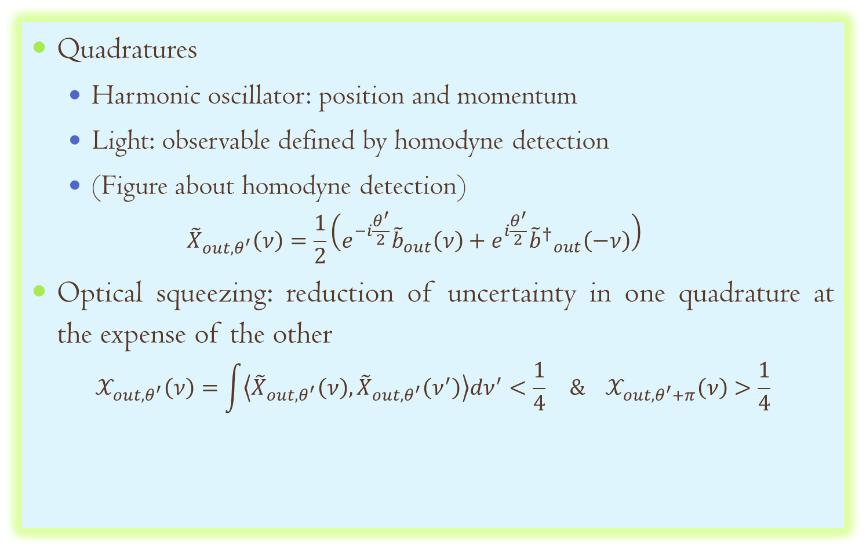
Optical squeezing
Quadratures
Harmonic oscillator: position and momentum
Light: observable defined by homodyne detection
(Figure about homodyne detection)
$${\tilde{X}}_{out,θ^{′}}\left(ν\right)=\frac{1}{2}\left(e^{−i\frac{θ^{′}}{2}}{\tilde{b}}_{out}\left(ν\right)+e^{i\frac{θ^{′}}{2}}{{\tilde{b}}^{†}}_{out}^{}\left(−ν\right)\right)$$
Optical squeezing: reduction of uncertainty in one quadrature at the expense of the other
$$𝒳_{out,θ^{′}}\left(ν\right)=\int{\left\langle {\tilde{X}}_{out,θ^{′}}\left(ν\right),{\tilde{X}}_{out,θ^{′}}\left(ν^{′}\right)\right\rangle dν^{′}<\frac{1}{4}} \& 𝒳_{out,θ^{′}+π}\left(ν\right)>\frac{1}{4}$$

Slide 5
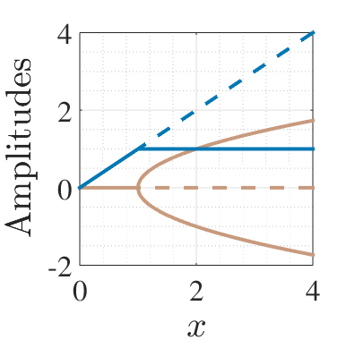
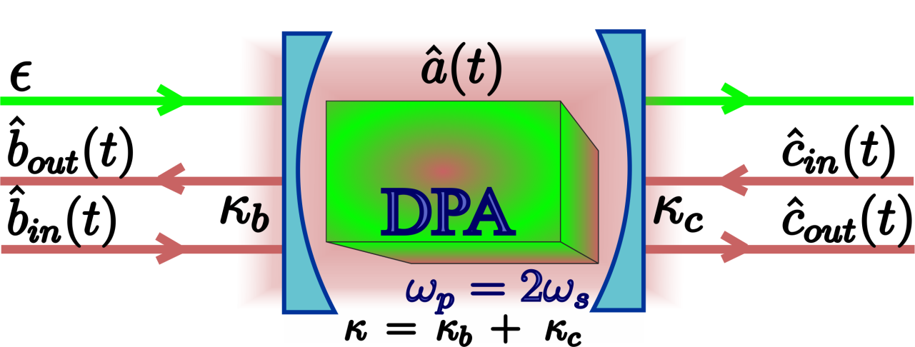
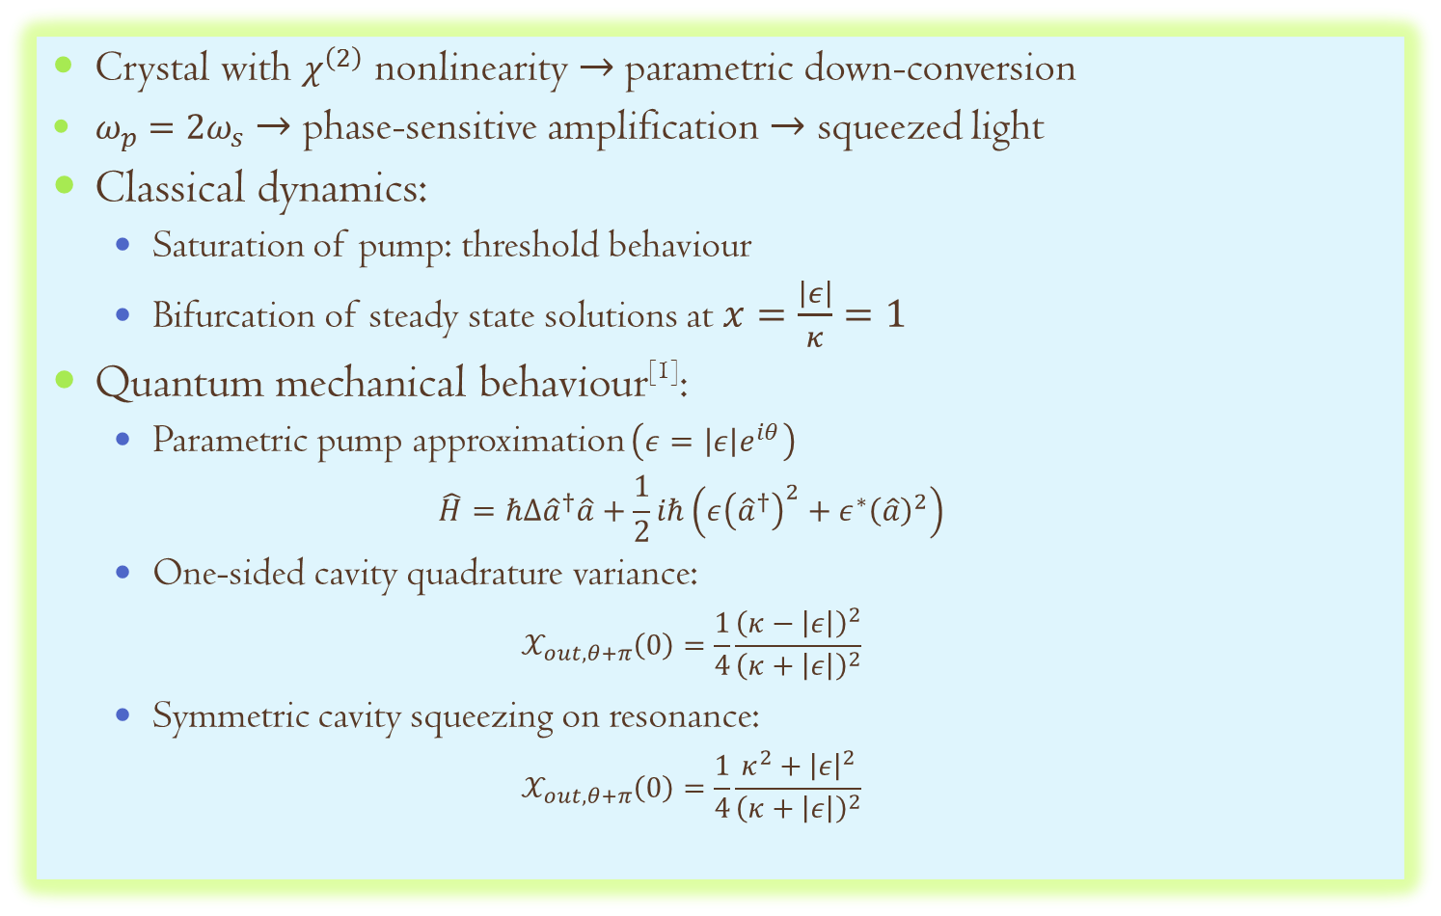
Degenerate Parametric Amplifier
Crystal with $χ^{\left(2\right)}$ nonlinearity $→$parametric down-conversion
$ω_{p}=2ω_{s}$ $→$ phase-sensitive amplification $→$ squeezed light
Classical dynamics:
Saturation of pump: threshold behaviour
Bifurcation of steady state solutions at $x=\frac{\left|ε\right|}{κ}=1$
Quantum mechanical behaviour^{[1]}:
Parametric pump approximation $\left(ε=\left|ε\right|e^{iθ}\right)$
$$\hat{H}=ℏΔ{\hat{a}}^{†}\hat{a}+\frac{1}{2}iℏ\left(ε{\left({\hat{a}}^{†}\right)}^{2}+ε^{∗}{\left(\hat{a}\right)}^{2}\right)$$
One-sided cavity quadrature variance:
$$𝒳_{out,θ+π}\left(0\right)=\frac{1}{4}\frac{{\left(κ−\left|ε\right|\right)}^{2}}{{\left(κ+\left|ε\right|\right)}^{2}}$$
Symmetric cavity squeezing on resonance:
$$𝒳_{out,θ+π}\left(0\right)=\frac{1}{4}\frac{κ^{2}+{\left|ε\right|}^{2}}{{\left(κ+\left|ε\right|\right)}^{2}}$$

Slide 6
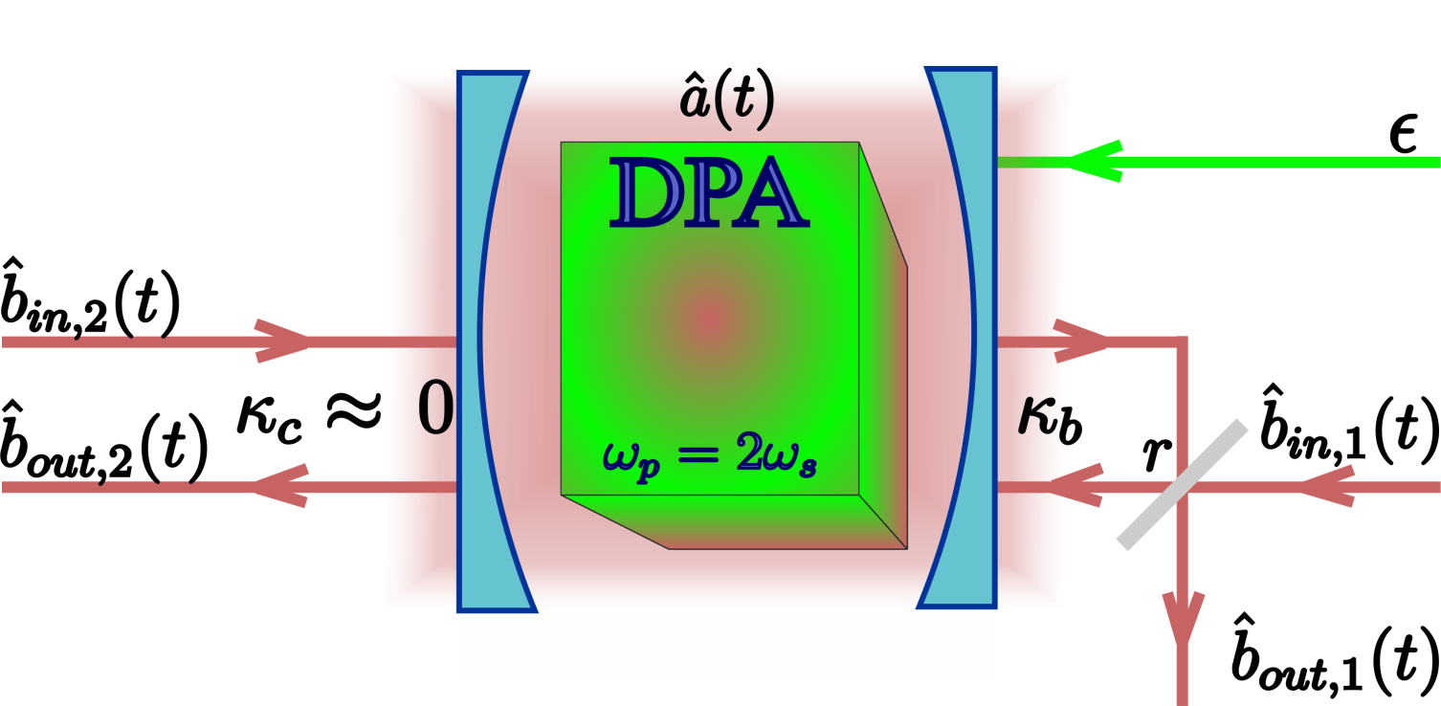
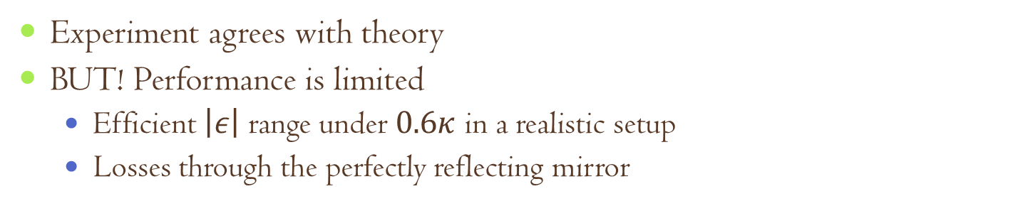
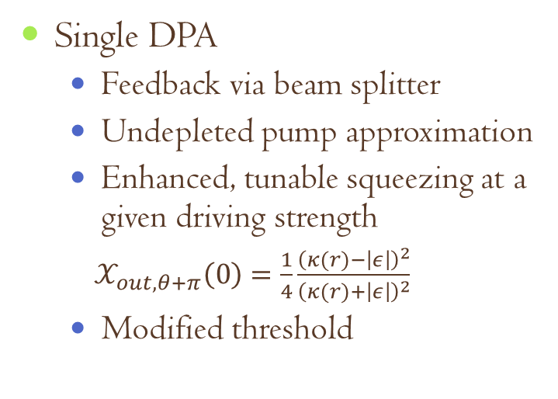
Coherent feedback with DPA
Coherent feedback: Quantum feedback without measurement
Single DPA
Feedback via beam splitter
Undepleted pump approximation
Enhanced, tunable squeezing at a given driving strength
$𝒳_{out,θ+π}\left(0\right)=\frac{1}{4}\frac{{\left(κ(r)−\left|ε\right|\right)}^{2}}{{\left(κ(r)+\left|ε\right|\right)}^{2}}$
Modified threshold
Experiment agrees with theory
BUT! Performance is limited
Efficient $\left|ε\right|$ range under $0.6κ$ in a realistic setup
Losses through the perfectly reflecting mirror
^{[1]} J. E. Gough, S. Wildfeuer, PRA, 80:042107 (2009), ^{[2]}A. Furusawa’s group, IEEE Trans. Auto. Contr., 57:2045 (2012)

Slide 7
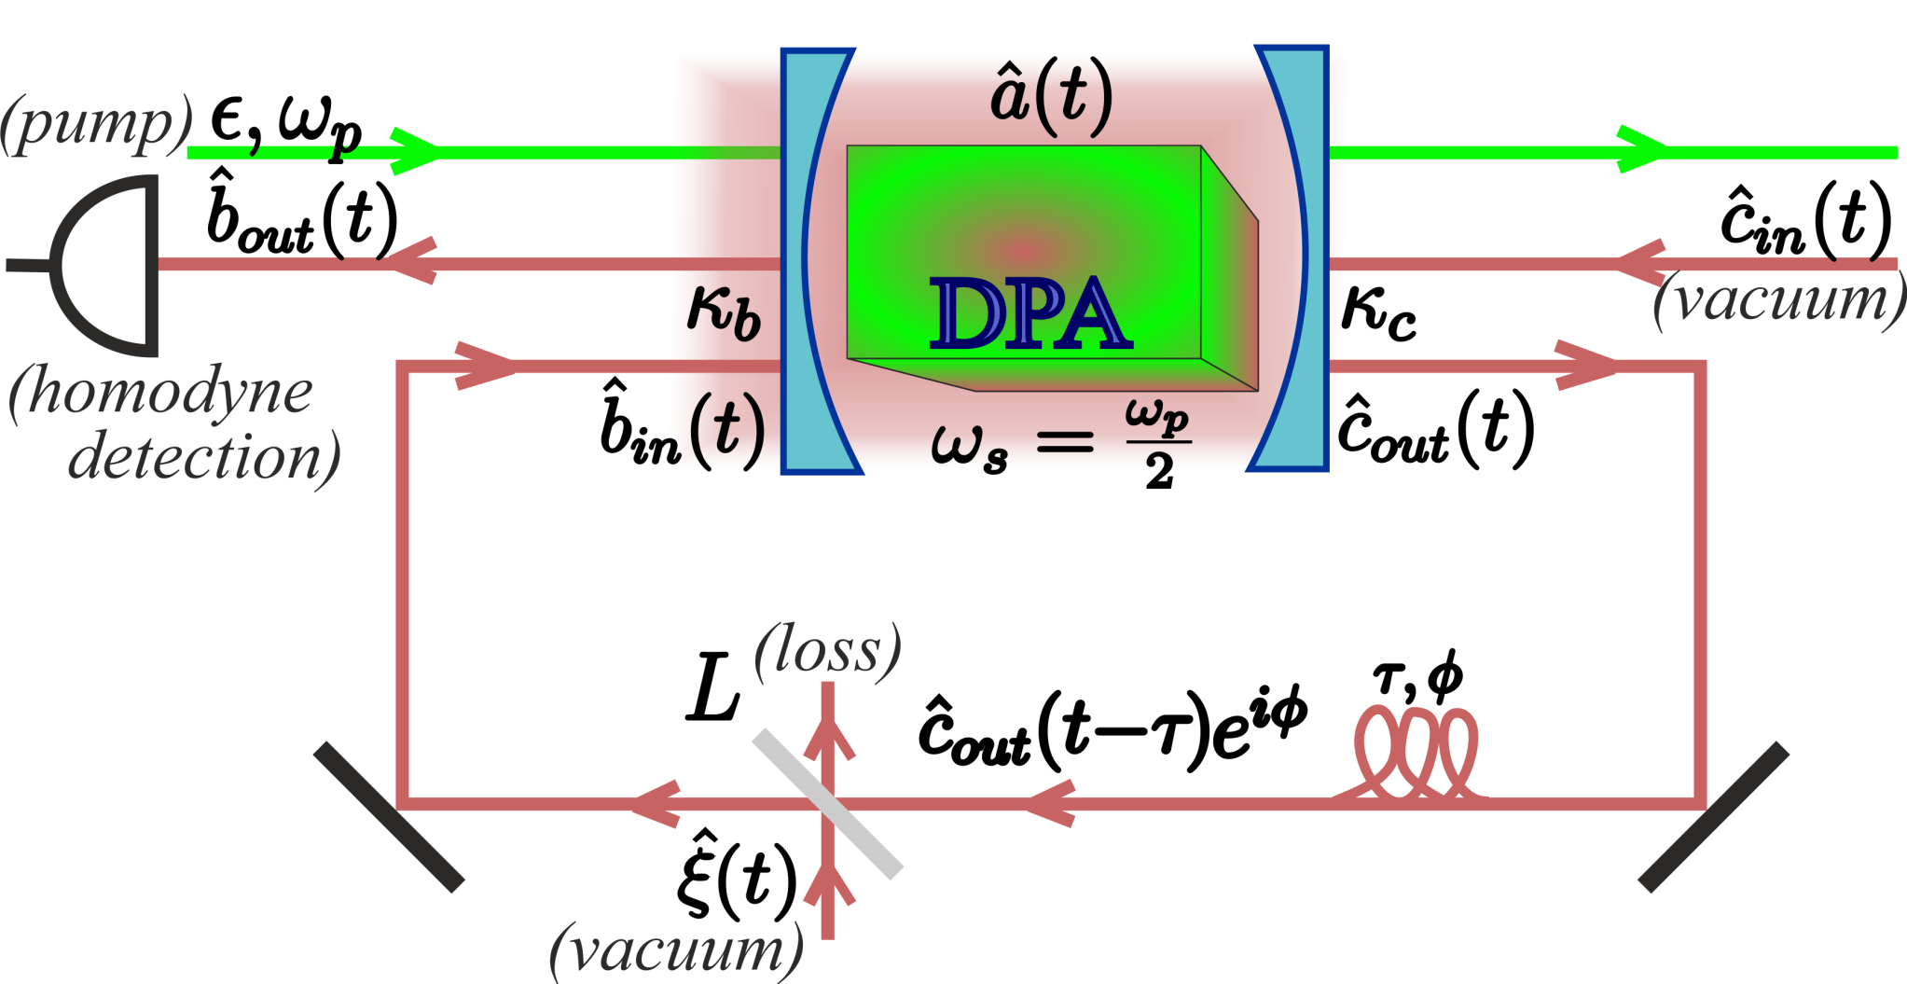
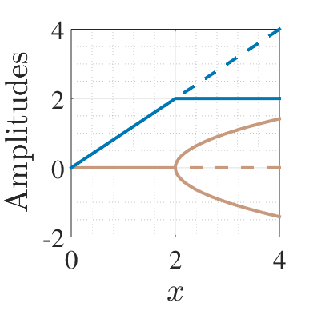
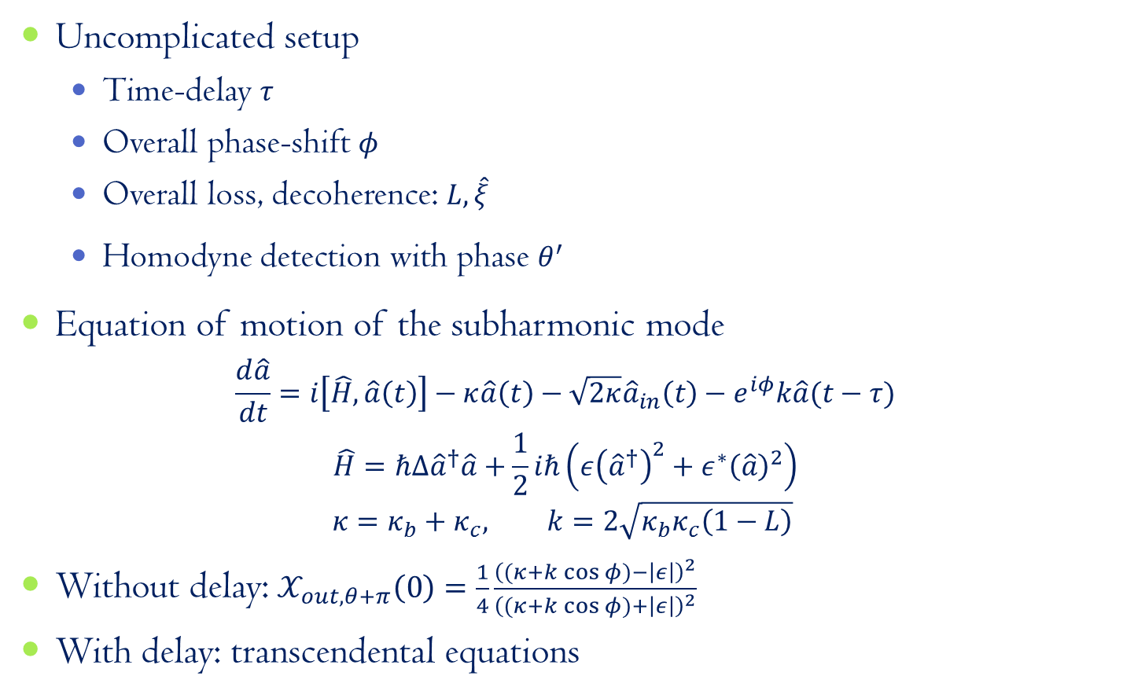
DPA with time-delayed coherent feedback
Uncomplicated setup
Time-delay $τ$
Overall phase-shift $φ$
Overall loss, decoherence: $L,\hat{ξ}$
Homodyne detection with phase $θ^{′}$
Equation of motion of the subharmonic mode
$$\frac{d\hat{a}}{dt}=i\left[\hat{H},\hat{a}\left(t\right)\right]−κ\hat{a}\left(t\right)−\sqrt{2κ}{\hat{a}}_{in}\left(t\right)−e^{iφ}k\hat{a}(t−τ)$$
$$\hat{H}=ℏΔ{\hat{a}}^{†}\hat{a}+\frac{1}{2}iℏ\left(ε{\left({\hat{a}}^{†}\right)}^{2}+ε^{∗}{\left(\hat{a}\right)}^{2}\right)$$
$$κ=κ_{b}+κ_{c}, k=2\sqrt{κ_{b}κ_{c}\left(1−L\right)}$$
Without delay: $𝒳_{out,θ+π}\left(0\right)=\frac{1}{4}\frac{{\left((κ+k\cos{φ})−\left|ε\right|\right)}^{2}}{{\left((κ+k\cos{φ})+\left|ε\right|\right)}^{2}}$
With delay: transcendental equations

Slide 8
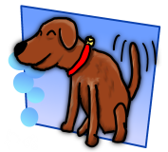

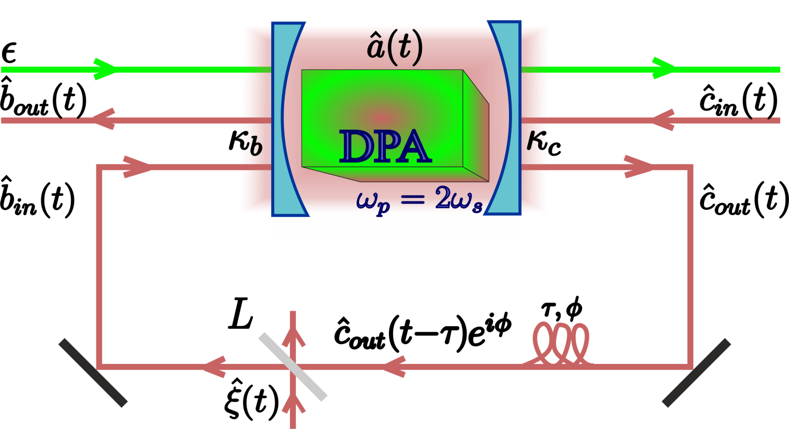
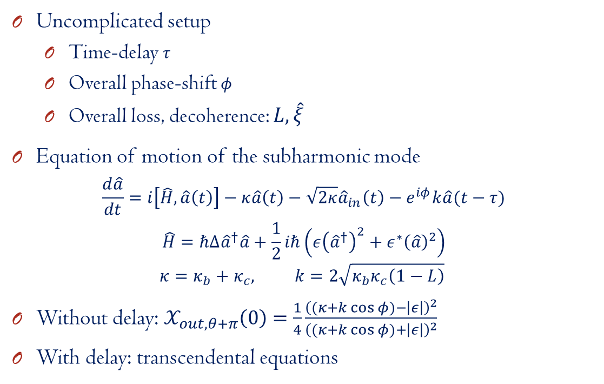
DPA with delayed coherent feedback
Uncomplicated setup
Time-delay $τ$
Overall phase-shift $φ$
Overall loss, decoherence: $L,\hat{ξ}$
Equation of motion of the subharmonic mode
$$\frac{d\hat{a}}{dt}=i\left[\hat{H},\hat{a}\left(t\right)\right]−κ\hat{a}\left(t\right)−\sqrt{2κ}{\hat{a}}_{in}\left(t\right)−e^{iφ}k\hat{a}(t−τ)$$
$$\hat{H}=ℏΔ{\hat{a}}^{†}\hat{a}+\frac{1}{2}iℏ\left(ε{\left({\hat{a}}^{†}\right)}^{2}+ε^{∗}{\left(\hat{a}\right)}^{2}\right)$$
$$κ=κ_{b}+κ_{c}, k=2\sqrt{κ_{b}κ_{c}\left(1−L\right)}$$
Without delay: $𝒳_{out,θ+π}\left(0\right)=\frac{1}{4}\frac{{\left((κ+k\cos{φ})−\left|ε\right|\right)}^{2}}{{\left((κ+k\cos{φ})+\left|ε\right|\right)}^{2}}$
With delay: transcendental equations

Slide 9
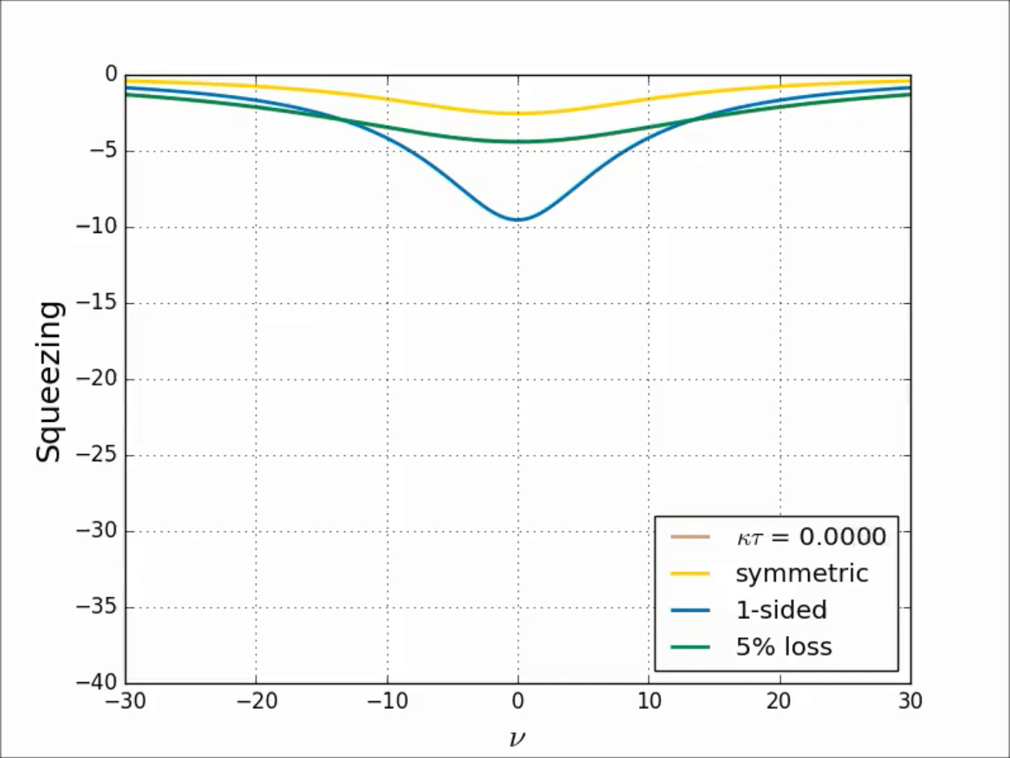
Squeezing spectra^{[1]}
^{[1]}M. J. Collett, C. W. Gardiner, PRA, 30:1386 (1984)

Slide 10
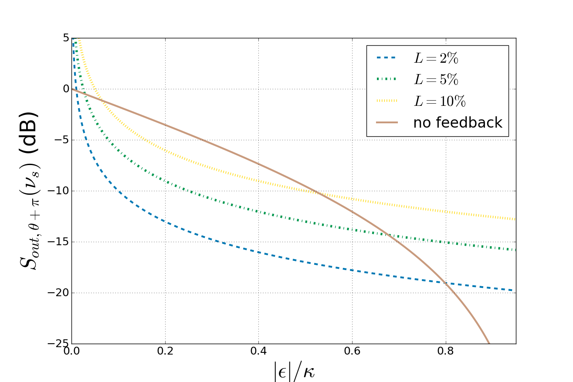

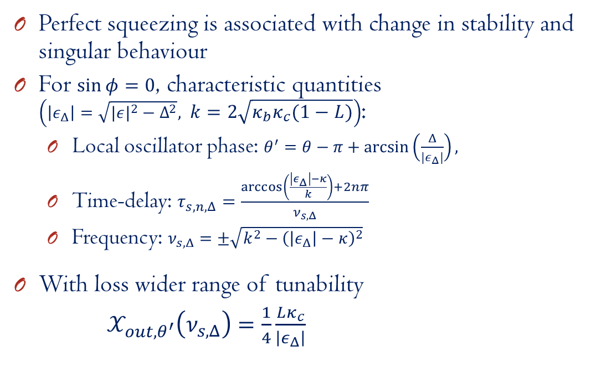
When do these peaks appear?
Perfect squeezing is associated with change in stability and singular behaviour
For $\sin{φ}=0$, characteristic quantities $\left(\left|ε_{Δ}\right|=\sqrt{|{ε|}^{2}−Δ^{2}}, k=2\sqrt{κ_{b}κ_{c}\left(1−L\right)}\right)$:
Local oscillator phase: $θ^{′}=θ−π+\arcsin\left(\frac{Δ}{{|ε}_{Δ}|}\right),$
Time-delay: $τ_{s,n,Δ}=\frac{\arccos\left(\frac{\left|ε_{Δ}\right|−κ}{k}\right)+2nπ}{ν_{s,Δ}}$
Frequency: $ν_{s,Δ}=±\sqrt{k^{2}−{\left(\left|ε_{Δ}\right|−κ\right)}^{2}}$
With loss wider range of tunability
$𝒳_{out,θ^{′}}\left(ν_{s,Δ}\right)=\frac{1}{4}\frac{Lκ_{c}}{\left|ε_{Δ}\right|}$

Slide 11
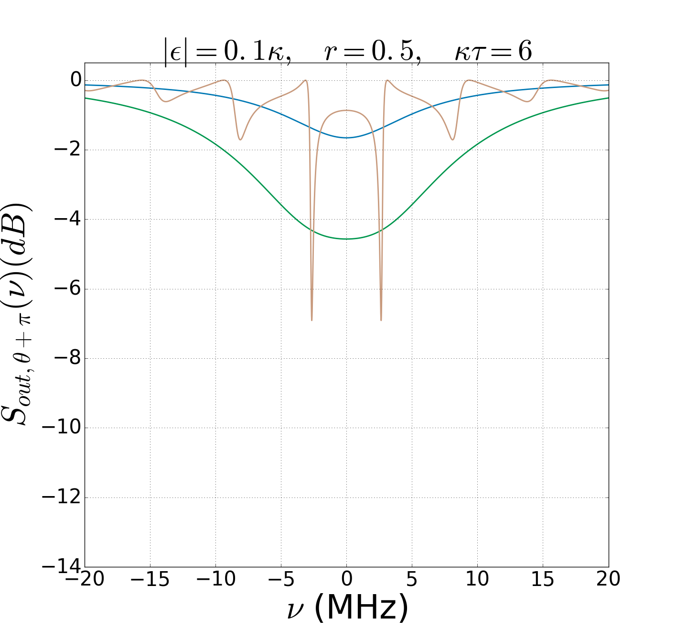
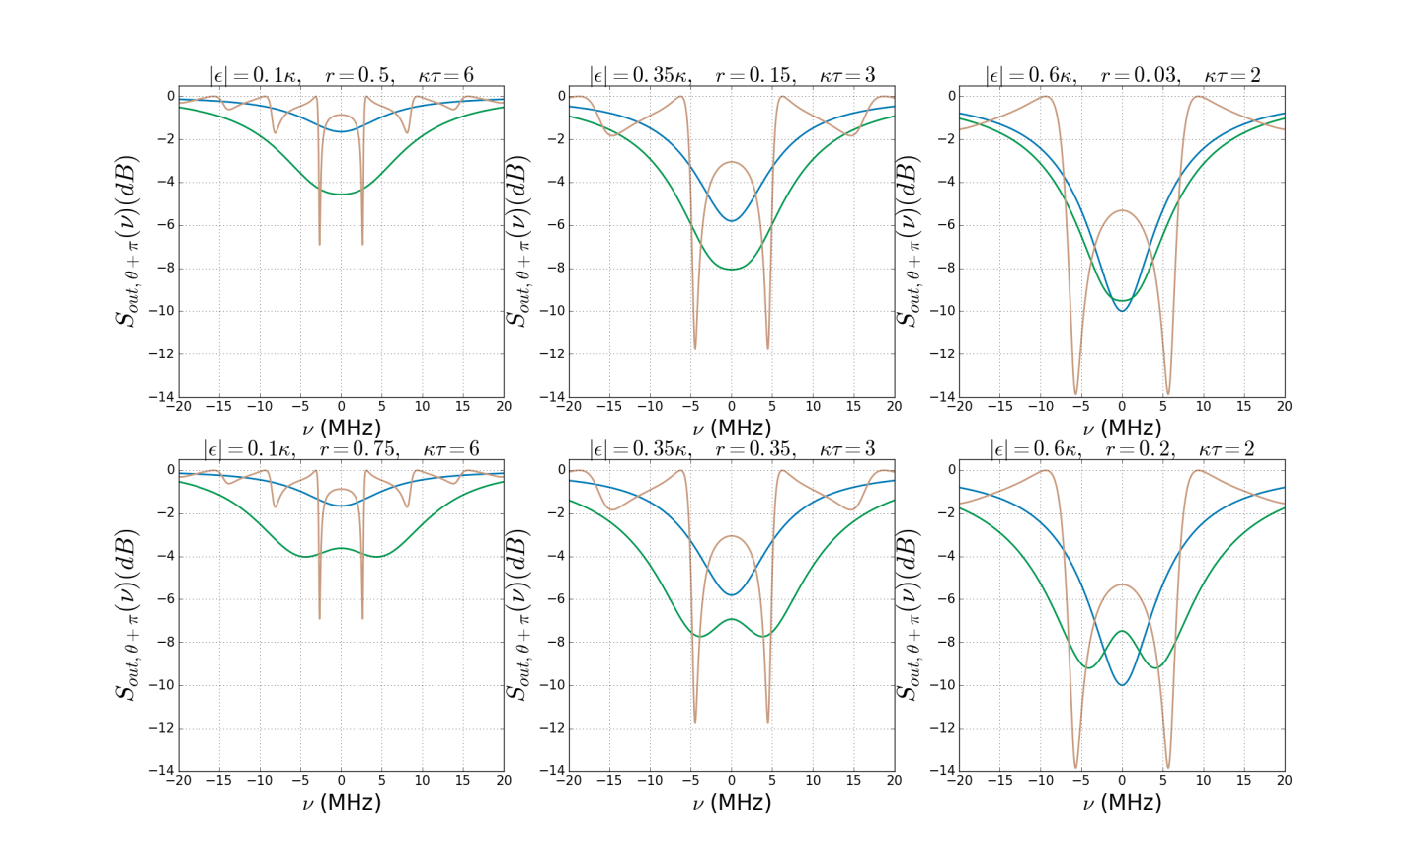
Comparison with previous results^{[1,2]}
with BS
feedback
without
feedback
with delayed feedback
without
feedback
with BS
feedback
without
feedback
with BS
feedback
with delayed feedback
with delayed feedback
^{[1]} M. J. Collett, C. W. Gardiner, PRA, 30:1386 (1984), ^{2]}A. Furusawa’s group, IEEE Trans. Auto. Contr., 57:2045 (2012)

Slide 12
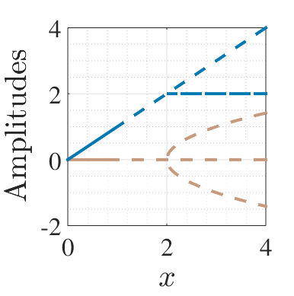
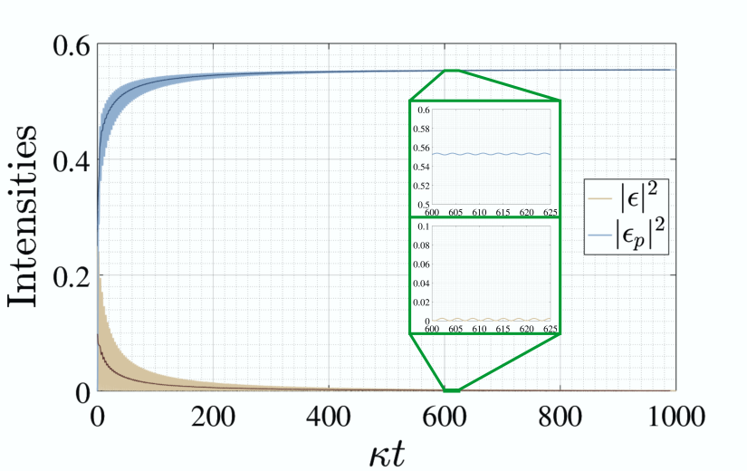
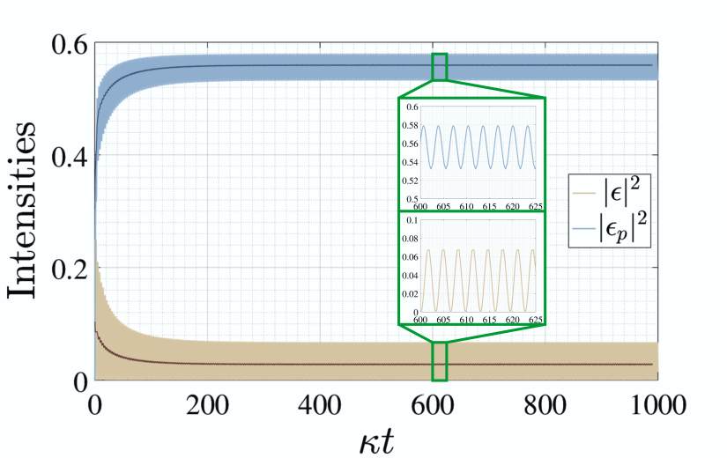
Classical analysis
Time-delay: Changing stability of steady state solutions
Hopf bifurcation
Imaginary eigenvalue becomes the frequency of persistent oscillations

Slide 13
Summary
Coherent feedback: backaction-free way of enhancing useful quantum properties
Time-delay: tunable changes in the stability range
In a time-delayed one-loop setup with a DPA, dramatically enhanced squeezing was found
Enhancement even compared to previous feedback setups
Result of the changing dynamics of the system
Loss in the feedback loop decreases the degree of squeezing, but also provides higher tunability

Slide 14

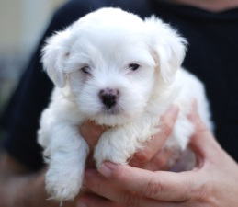

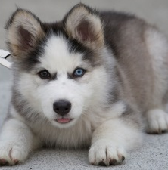



Thank you for Your
1
2
attention!
3
4
5
6
7
8

Slide 15
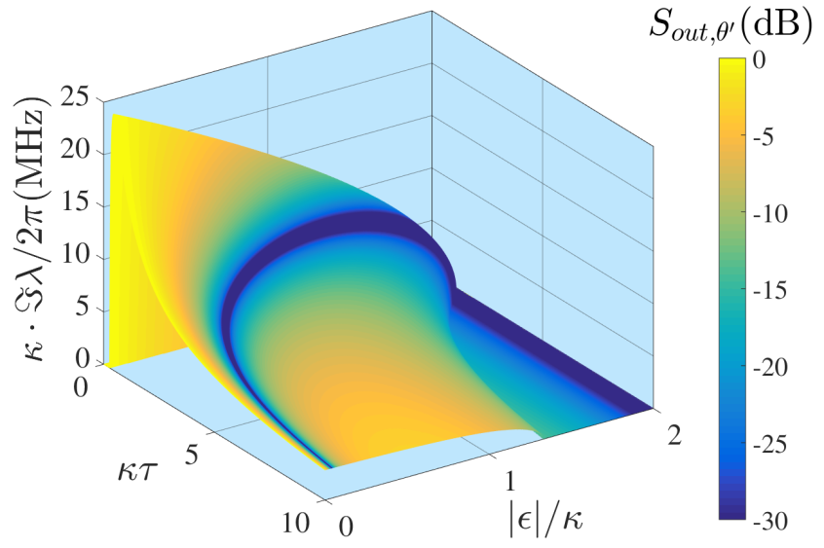
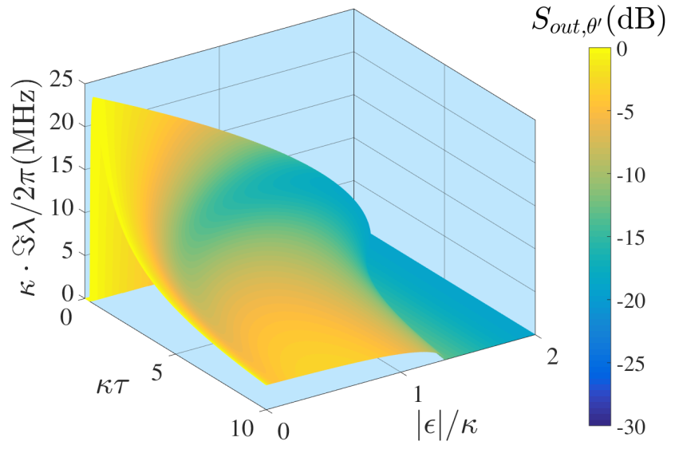
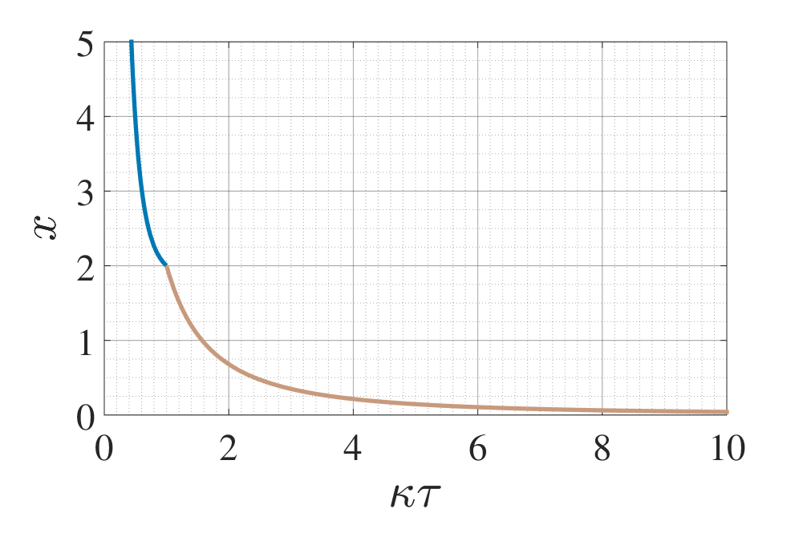
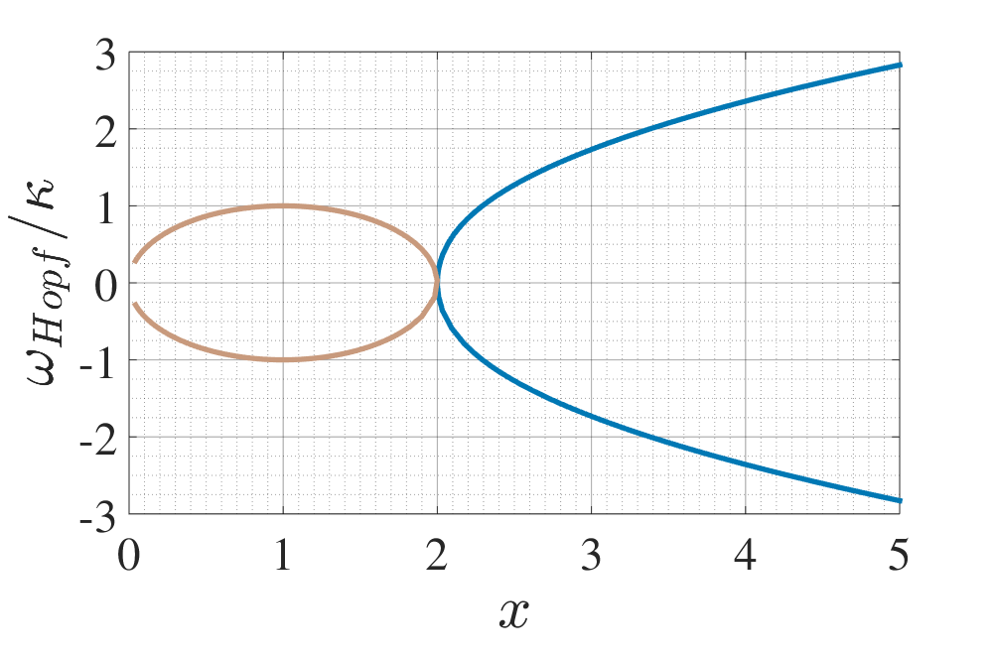
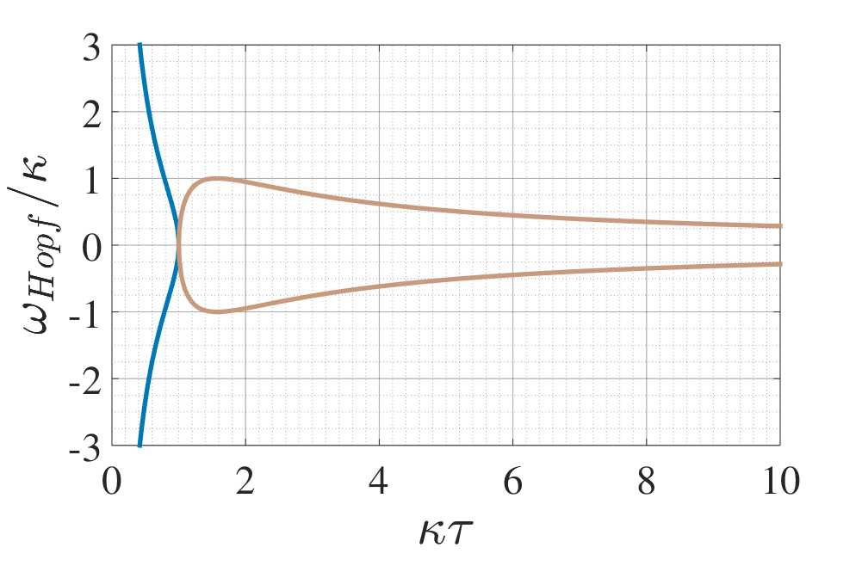
Tunability
$$0≤ν_{s}≤\sqrt{\left|ε\right|\left(2κ−\left|ε\right|\right)},0≤\left|ε\right|≤\left|κ+ke^{iφ}\right|$$

Slide 16
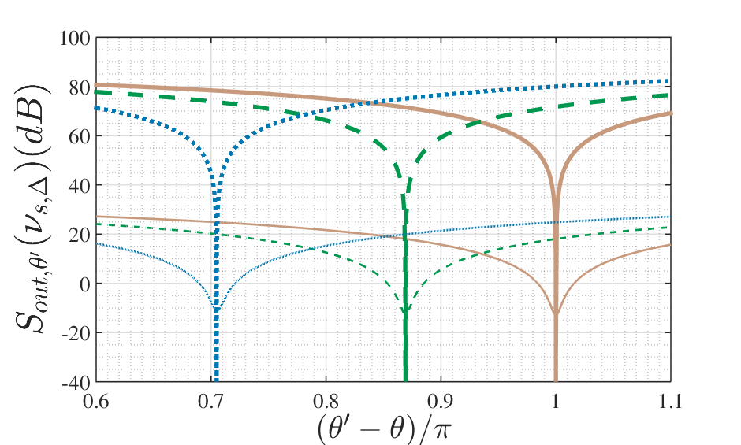
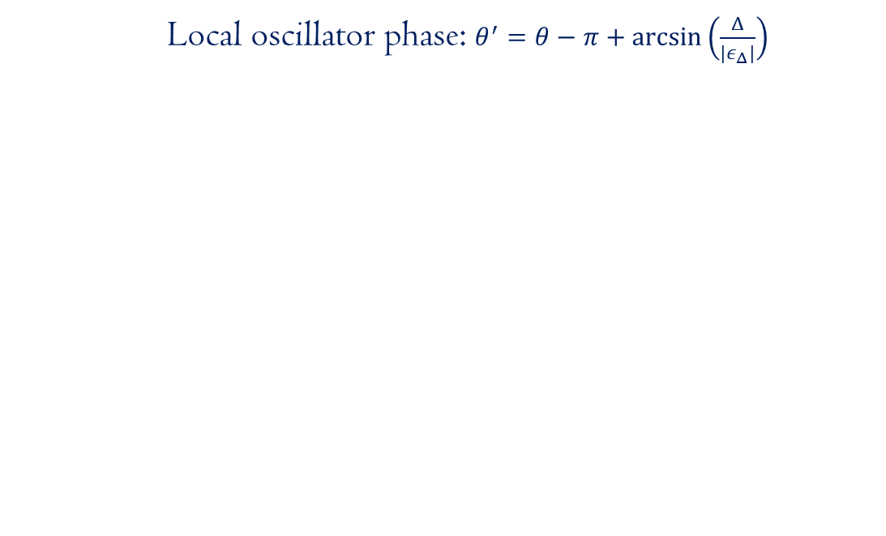
Detuning and quadrature angle
Local oscillator phase: $θ^{′}=θ−π+\arcsin\left(\frac{Δ}{{|ε}_{Δ}|}\right)$

Slide 17
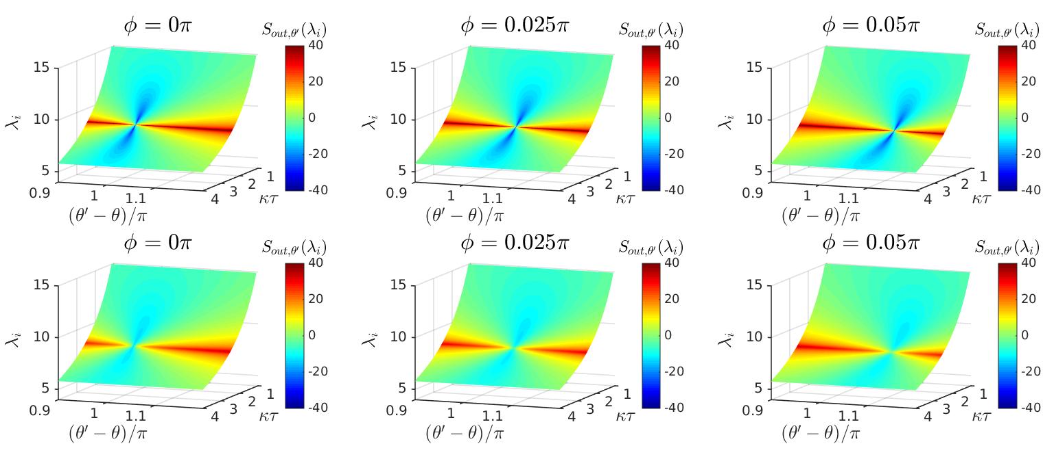
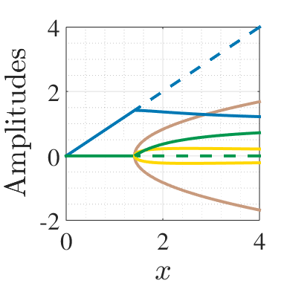
Effects of the phase shift

Slide 18
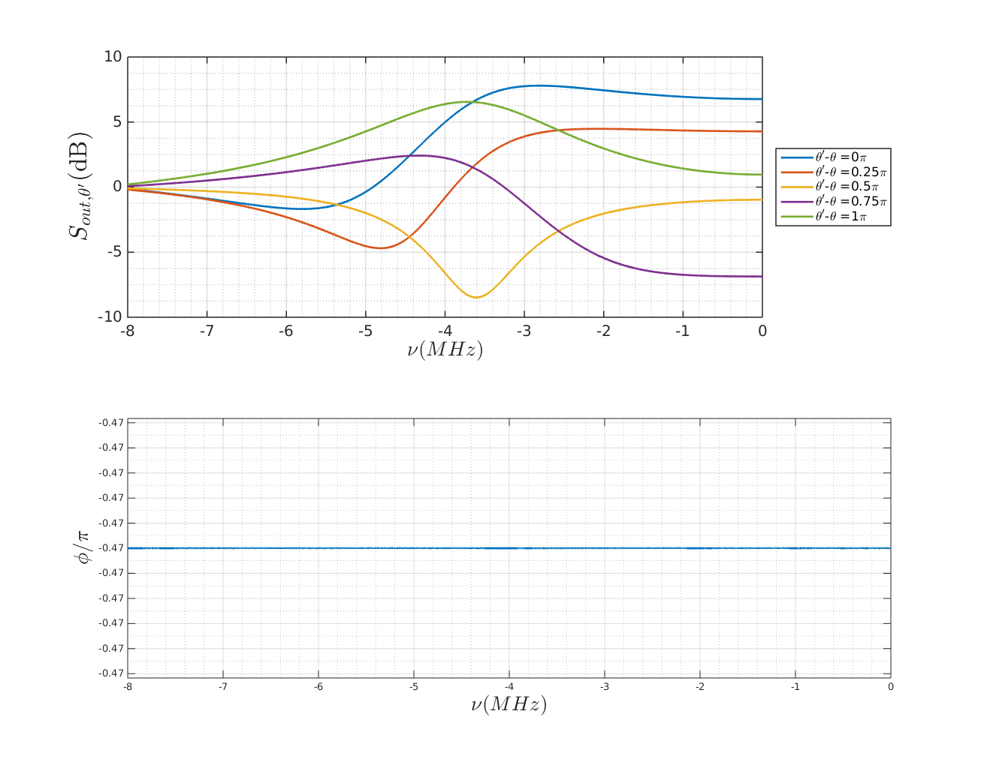
Gravitational wave detection

Slide 19
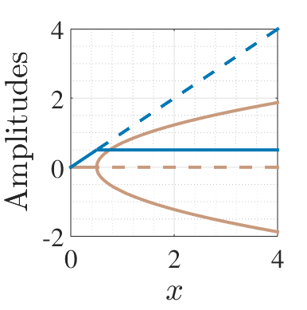
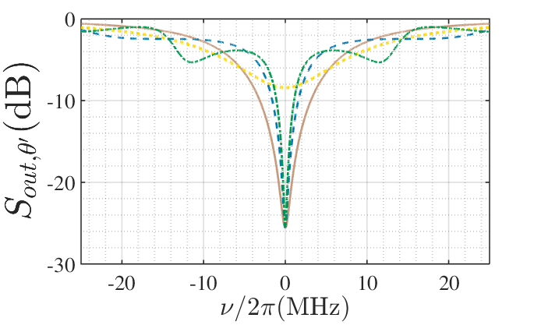
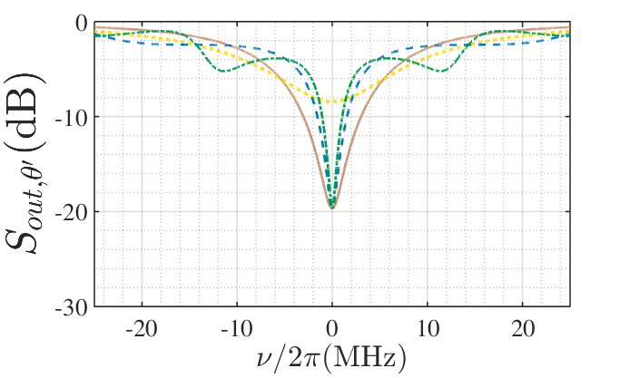
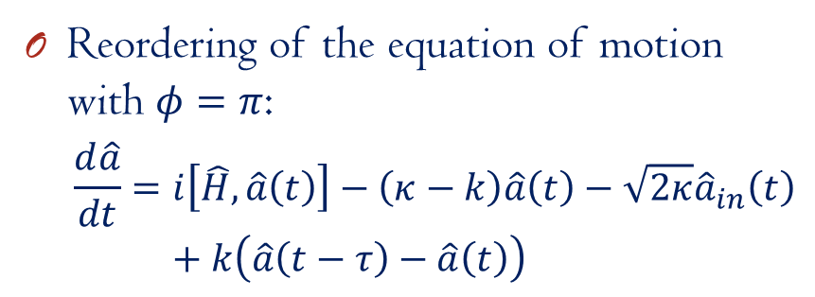
Pyragas-type feedback^{[1,2]}
Reordering of the equation of motion with $φ=π$:
$$\frac{d\hat{a}}{dt}=i\left[\hat{H},\hat{a}\left(t\right)\right]−\left(κ−k\right)\hat{a}\left(t\right)−\sqrt{2κ}{\hat{a}}_{in}\left(t\right)+k\left(\hat{a}\left(t−τ\right)−\hat{a}\left(t\right)\right)$$
^{[1]}K. Pyragas, PLA, 170:421 (1992), ^{[2]}A. L. Grimsmo, A. S. Parkins, B. S. Skagerstam, NJP 16:065004 (2014),

Slide 20
More previous studies
Plant and controller system
Controller: two-mode squeezer
C. Bian, G. Zhang, H. W. J. Lee, Int. J. Cont. 85:1865 (2012)
2 OPOs coupled in a feedback loop with a phase difference
H. Mabuchi’s group, Opt. Express 21:1 (2013)
Trapped modes in a linear system
Z. Shi, H. I. Nurdin, arXiv: 1510.08942
Delayed feedback for discreet quantum information: A. Knorr’s group

